Slide 1
Data Structures

Slide 2
Agenda
Merge Sort
Quick Sort

Slide 3
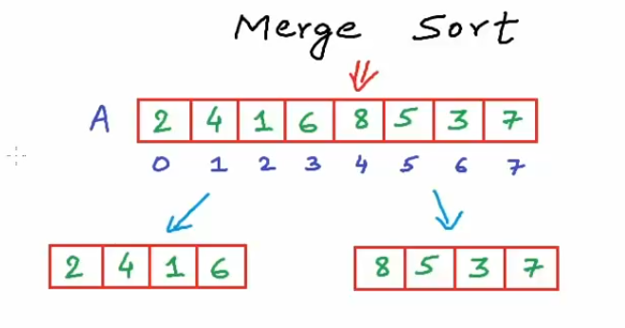
Merge Sort
Divide and Conquer
Recursive – Reducing a problem in a self similar manner
Not in-place
O(nlog(n)) time complexity.
If we somehow get these subarrays sorted, we can merge them into the original list.

Slide 4
Merge Sort

Slide 5
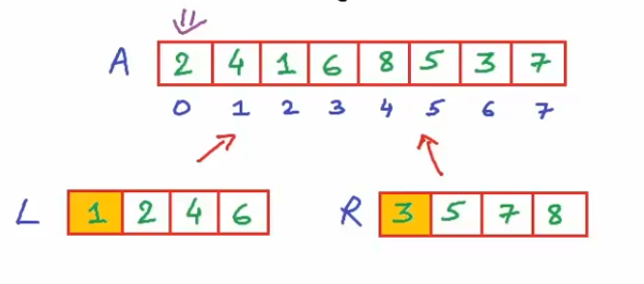
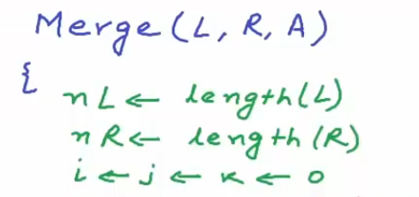
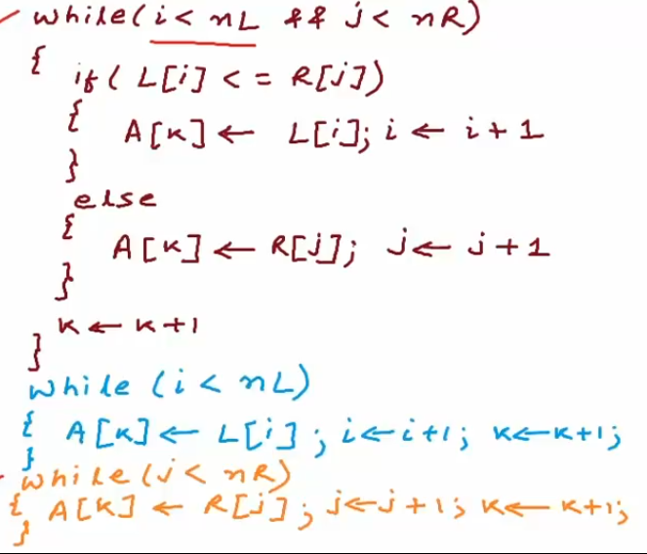
Merge Sort

Slide 6
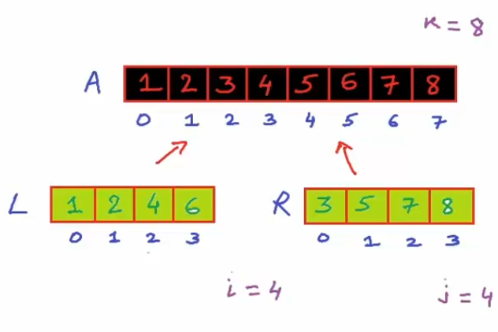
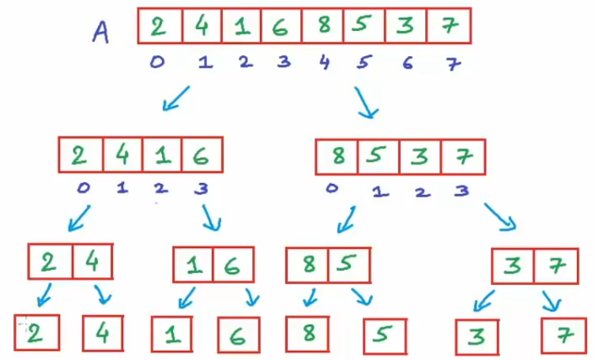
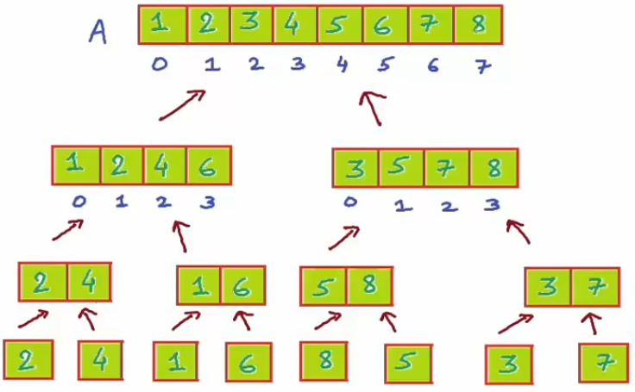
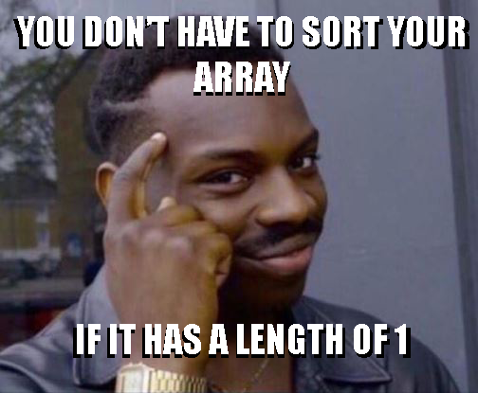
Merge Sort

Slide 7
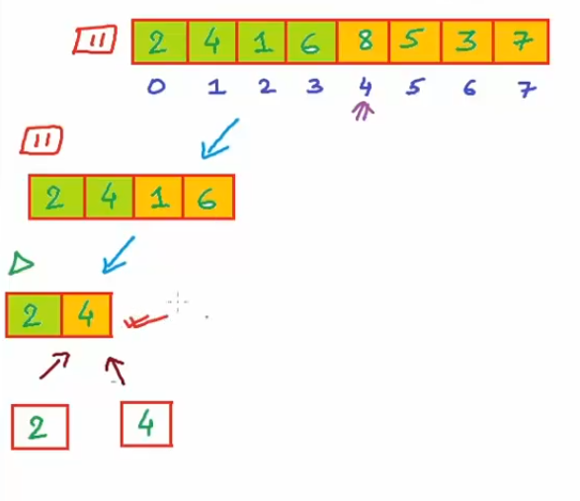
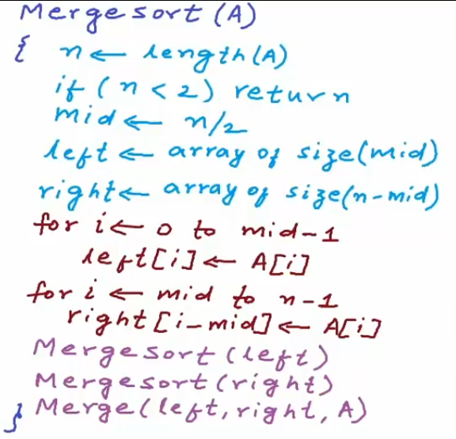
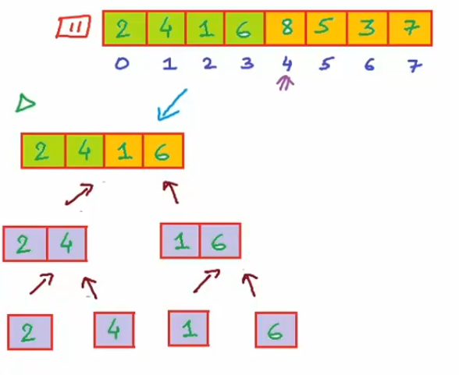
Merge Sort

Slide 8
Merge Sort – Time Complexity

Slide 9
Merge Sort – Time Complexity

Slide 10
Merge Sort – Time Complexity

Slide 11
Merge Sort – Time Complexity

Slide 12
Merge Sort – Time Complexity

Slide 13
Merge Sort – Space Complexity

Slide 14
Quick Sort

Slide 15
Quick Sort

Slide 16
Quick Sort

Slide 17
THANK YOU

